Slide 1
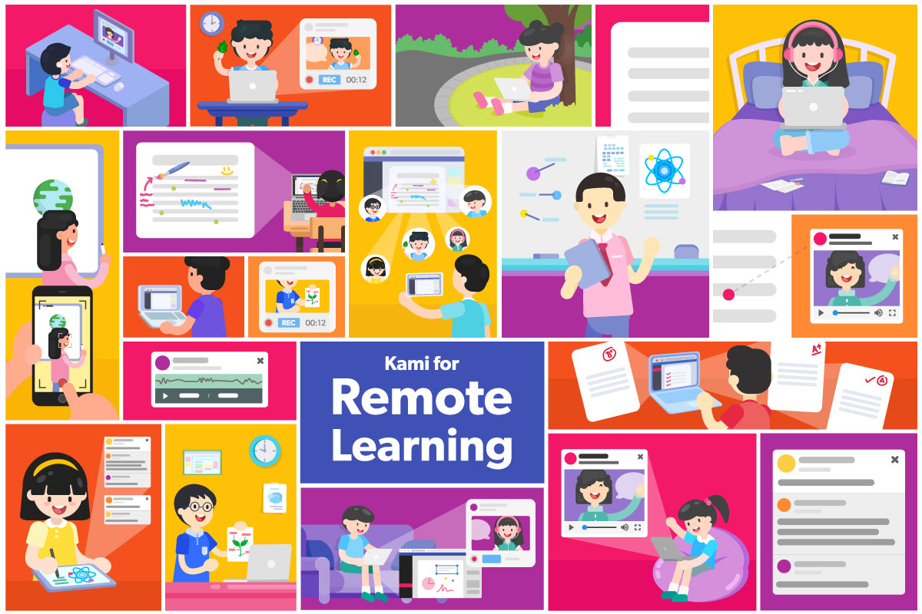
Remote learning
BSS
Believe, Strive, Succeed Corinthians 1:12:12 ‘the body is one and has many members, and all the members of the body, though many, are one body’

Slide 2
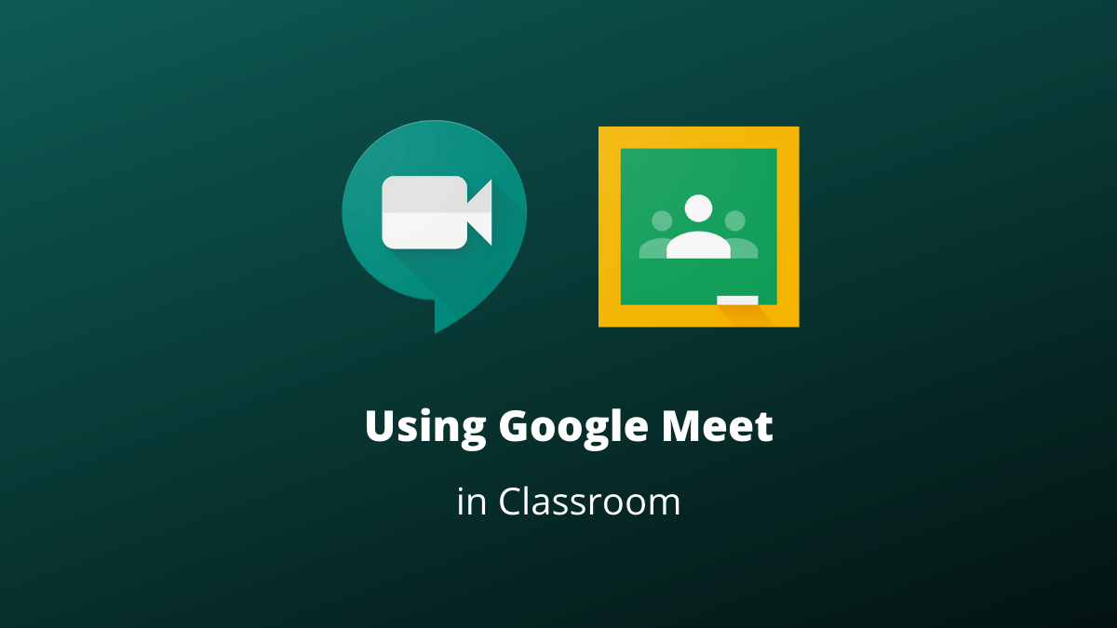
How to use Google Meets
Believe, Strive, Succeed Corinthians 1:12:12 ‘the body is one and has many members, and all the members of the body, though many, are one body’

Slide 3
Login to Google Classroom and select the class that you are timetabled to have
Believe, Strive, Succeed Corinthians 1:12:12 ‘the body is one and has many members, and all the members of the body, though many, are one body’

Slide 4
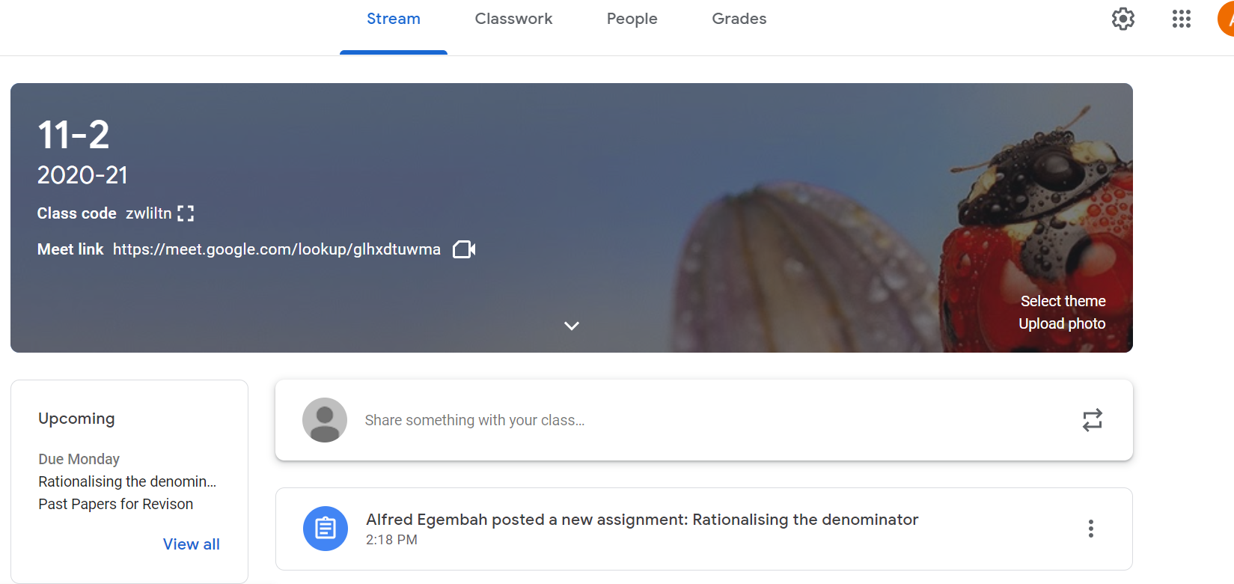
On the Classroom page, click on the video link button under the title of the class
The link will not always be open. Only when you have a live stream lesson
Believe, Strive, Succeed Corinthians 1:12:12 ‘the body is one and has many members, and all the members of the body, though many, are one body’

Slide 5
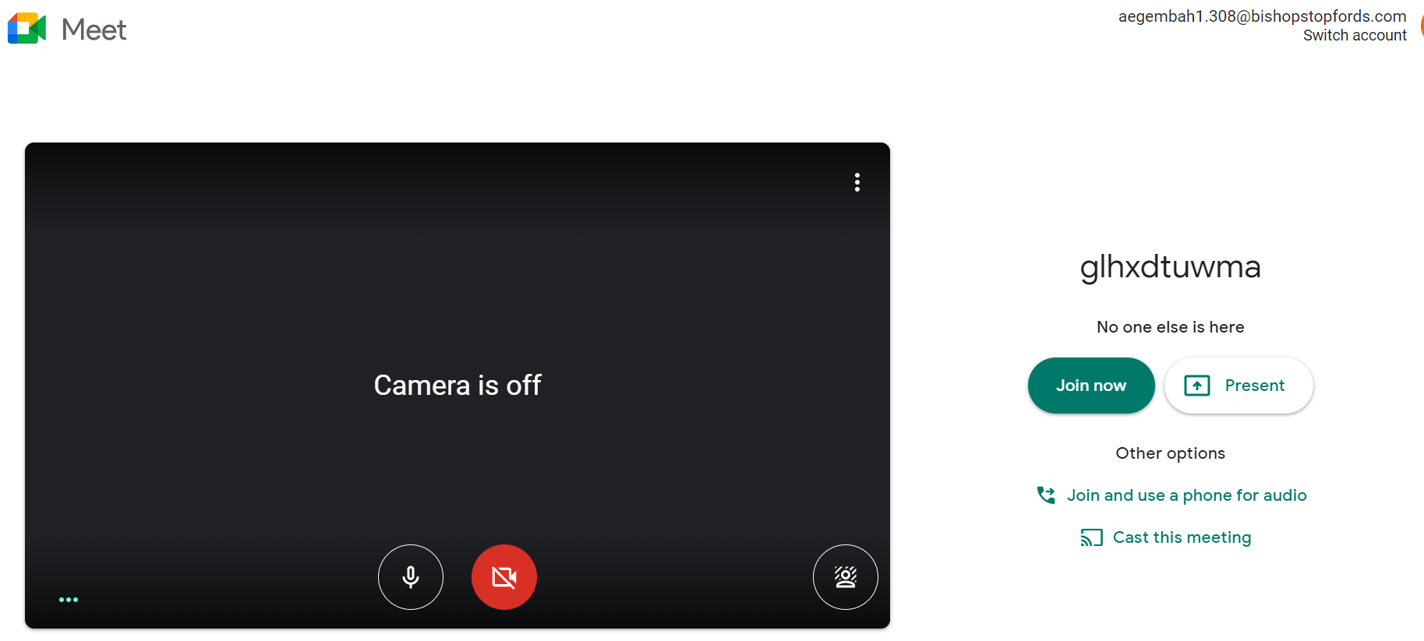
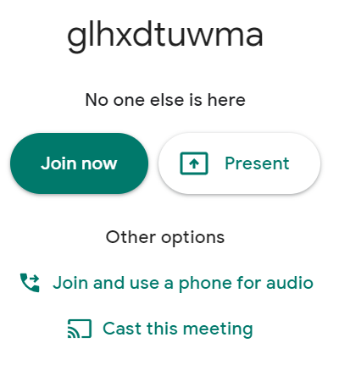
Before you click ‘Join Now’ make sure you are ready to enter the classroom and you can be seen in the camera and your microphone is on
Join now will take you into the live stream class
Your controls for the camera and microphone
Believe, Strive, Succeed Corinthians 1:12:12 ‘the body is one and has many members, and all the members of the body, though many, are one body’

Slide 6
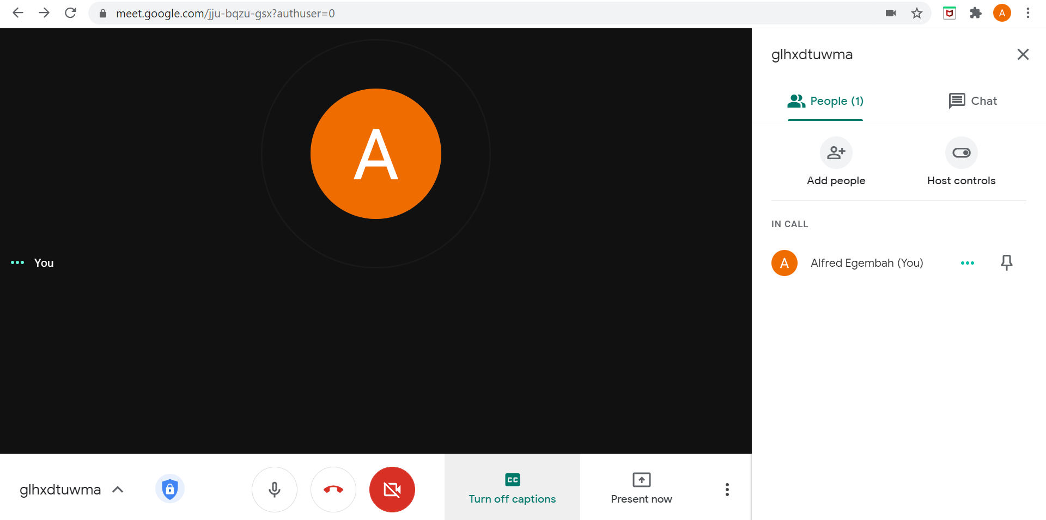
When in the class, make sure your teacher has registered your attendance and then turn off your camera and mute your microphone
Believe, Strive, Succeed Corinthians 1:12:12 ‘the body is one and has many members, and all the members of the body, though many, are one body’

Slide 7
Turning on Captions will dictate what your teacher is saying. Use this if your audio doesn’t work
Believe, Strive, Succeed Corinthians 1:12:12 ‘the body is one and has many members, and all the members of the body, though many, are one body’

Slide 8
If at any point you have a question about the lesson, use the chat feature to type your question to your teacher
Google Meet – In Class
Believe, Strive, Succeed Corinthians 1:12:12 ‘the body is one and has many members, and all the members of the body, though many, are one body’

Slide 9
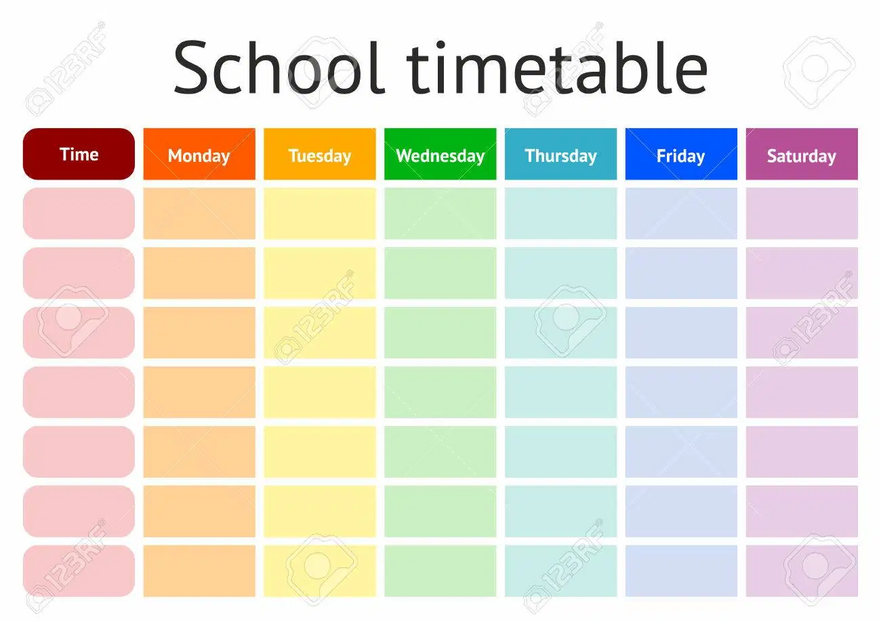
YOU NEED TO FOLLOW YOUR NORMAL SCHOOL TIMETABLE
Believe, Strive, Succeed Corinthians 1:12:12 ‘the body is one and has many members, and all the members of the body, though many, are one body’

Slide 10
Preparation
Make sure you have your book, equipment and anything else you need for the lesson prepared before you start.
Ensure that and mobile devices are turned off or on silent so they do not disrupt the lesson.
Think about where you'll be. Aim for a quiet space if you can, with good lighting, neutral background and nowhere personal (bedrooms). Ensure no family members are present or in the back ground
Make sure you dress appropriately in something that would be acceptable to wear in school.
Be near your router, and put other devices on your wifi into airplane mode, or turn them off, to maximise your internet signal
Believe, Strive, Succeed Corinthians 1:12:12 ‘the body is one and has many members, and all the members of the body, though many, are one body’

Slide 11
Before the Lesson
Make sure you login to the google classroom that is linked to the class at the start of your lesson. Clink on the link or camera icon
Make sure once you join the lesson your camera is turned on as well as your microphone. Once you have been registered by the teacher turn both of them off.
Believe, Strive, Succeed Corinthians 1:12:12 ‘the body is one and has many members, and all the members of the body, though many, are one body’

Slide 12
During the Live Stream Session
Check you can hear right at the start, and that your teacher can hear you.
If you are unsure about anything within the lesson, ask the teacher using the chat feature.
Remember your behaviour will be monitored as it normally would be in school and rewards and sanctions will be applied as normal
Lesson will last 50 minutes instead of an hour to allow you to have time between each lesson.
Believe, Strive, Succeed Corinthians 1:12:12 ‘the body is one and has many members, and all the members of the body, though many, are one body’

Slide 13
At the End of the Live Stream Session
Submit the work you have done within the lesson to your teacher, use photos if you cannot attached digitally.
Any homework needs to be submitted by the due date.
Ensure you log off the class
Believe, Strive, Succeed Corinthians 1:12:12 ‘the body is one and has many members, and all the members of the body, though many, are one body’

Slide 14
Expectations of Stopfordians During a Live Streaming Lesson
Books and Equipment should be ready for the start of the lesson
Mobile phones should be off or on silent to avoid distractions
Cameras and Microphones should stay off for the duration of the life lesson
Please do not put your camera or microphone on for any reason
Use the chat feature to alert your teacher of any problems or if you have any questions regarding the lesson
This lesson will last 50 minutes
Work is expected to be submitted on google classroom following the end of this lesson
If you fail to uphold the expectations of his live lesson you will be removed and not allowed to return
Believe, Strive, Succeed Corinthians 1:12:12 ‘the body is one and has many members, and all the members of the body, though many, are one body’

