Slide 1
Year 11 Exam Information Evening
Subject: VCERT Health and Fitness
Head of Department name/email: A. Jennings: ajennings@bishopstopfords.enfield.sch.uk
Course Content Covered | Content still to be covered
Unit 1 1.1 Skeletal System 1.2 Muscular System 1.3 Respiratory System 1.4 Cardiovascular System 1.5 Energy Systems 2.1 Effects of Health and fitness 3.1 Health and Fitness 3.2 Components of fitness 4.1 Principles of Training | Unit 2 1.1 Lifestyle Factors 2.1 Fitness Testing 2.2 Training Methods 2.3 Optimising a Health and fitness Programme 3.1 Health and fitness analysis
Believe, Strive, Succeed Corinthians 1:12:12 ‘the body is one and has many members, and all the members of the body, though many, are one body’

Slide 2
Year 11 Exam Information Evening
Exam Requirements
How it's assessed
1 exam lasting 1 hour 30 minutes worth 40%
Internally assessed coursework worth 60%
Believe, Strive, Succeed Corinthians 1:12:12 ‘the body is one and has many members, and all the members of the body, though many, are one body’

Slide 3
Year 11 Exam Information Evening
How can parents support?
Ensure they have sufficient notes on all topics.
Test them regularly on what they know.
Ask them about assessments and how they have performed.
Ensure they revise at least 2 hours a week
Online learning platforms/useful websites
Google classroom
Theeverlearner.com
Believe, Strive, Succeed Corinthians 1:12:12 ‘the body is one and has many members, and all the members of the body, though many, are one body’

Slide 4
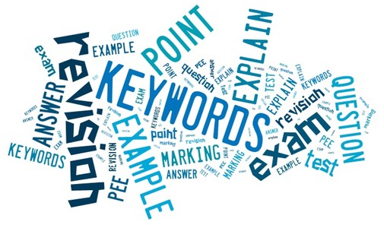
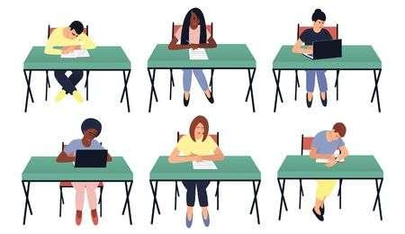
Year 11 Exam Information Evening
Key information (Upcoming Assessments)
All information about course and assessments is placed on Google classroom.
Trial exams to take place in November – Information relating to these exams will be shared with students in the lead up so that they can fully prepare.
Believe, Strive, Succeed Corinthians 1:12:12 ‘the body is one and has many members, and all the members of the body, though many, are one body’

